Slide 1
What is Economics?
1.1
Copyright Bananaomics

Slide 2
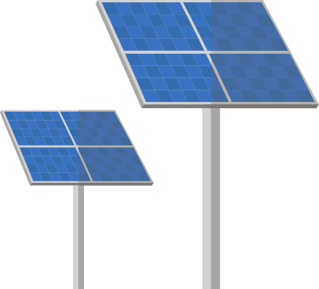
The 9 Central Concepts
Match the concept to the symbol you feel is correct
Efficiency
Scarcity
Choice
Interdependence
Equity
Sustainability
Economic Well-Being
Intervention
Change
Copyright Bananaomics

Slide 3
The 9 Central Concepts
Scarcity
Efficiency
Choice
Sustainability
Interdependence
ECONOMICS
Equity
Change
Intervention
Economic Well-Being
Copyright Bananaomics

Slide 4
Key Concept Activity
Pick two Key Concepts and find a news article written within the last year that fits with the concept! Write a few sentences explaining why.

Slide 5
Two Branches
Microeconomics
studies the behavior of individual economic agents such as consumers, households, firms, industries, and the government, and how they make economic decisions.
Macroeconomics
studies the economy as a whole, focusing on countries' fundamental economic goals.
Copyright Bananaomics

Slide 6
Discussion
Without any prior knowledge, define economics.
Copyright Bananaomics

Slide 7
Definition
Economics is
a social science.
the study of people in society
the study of rationing systems: how scarce resources meet the infinite wants of individuals.
Textbook Definition
Economics is the study of how societies use their scarce resources, which are needed to produce goods and services, to fulfill the unlimited needs and wants of the population, and distribute these goods and services among different groups.
Copyright Bananaomics

Slide 8
At the heart of economics is ..
Scarcity
Copyright Bananaomics

Slide 9
Scarcity
Scarcity - we have unlimited wants but limited resources
Due to scarcity, we are unable to have everything we desire. Therefore, we must make Choices about what resources we consume and which we give up. (Trade-Off)
Economics is the study of choices. In this section, we will study the choices of individuals, firms, and governments.
Copyright Bananaomics

Slide 10
Costs
Due to scarcity, individuals, firms, and governments must make choices. All choices come with a trade-off.
Trade-Off: All the alternatives that are given up when a choice is made.
Opportunity Cost: The next best-alternative that is given up when a choice is made.
Copyright Bananaomics

Slide 11
Opportunity Cost
Scarcity leads to choices. Choices lead to trade-offs. But not all trade-offs are equal.
Opportunity Cost
The next bext choice/alternative given up when a decision is made
Example
You and your friends are deciding what you would like to eat. You decide you want Italian food. At the restaurant, you are debating between pizza or pasta. You choose pizza.
What is your opportunity cost?
Copyright Bananaomics

Slide 12
Factors of Production
Think of a good or service you purchase regularly purchase. List out all the resources used to make that product or service. Be EXTENSIVE!
Copyright Bananaomics

Slide 13
Resources
All Resources can be classified into one of the Factors of Production
CELL
Capital
Labour
Entrepreneurship
Land
Copyright Bananaomics

Slide 14
Capital
Physical Capital
Any Human-made resource used to create other goods or services.
Human Capital
Skills or knowledge gained through education or experience
Copyright Bananaomics

Slide 15
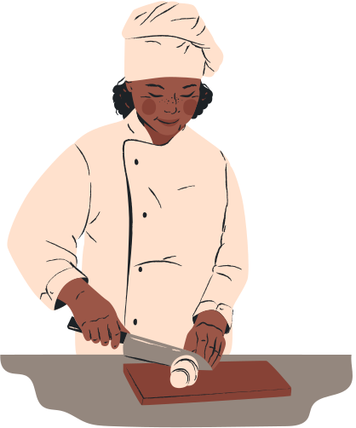
Entrepreneurship
Leaders who bring together other factors of production to create goods and services. Their primary motivation is PROFIT
Copyright Bananaomics

Slide 16
Land
Any Natural Resource used to produce goods or services. Anything that comes naturally from the Earth
Copyright Bananaomics

Slide 17
Labour
A person who devotes effort to a task and who is usually paid.
Copyright Bananaomics

Slide 18
Decision Making
When analyzing choices, economists will "Thinking on the Margin" (Marginal Analysis) which simply put, means making decisions based on increments.
Examples
1 additional hour of study time
30 more minutes of TV Time
1 additional slice of pizza to eat
Copyright Bananaomics

Slide 19
Three Basic Economic Questions
Copyright Bananaomics

Slide 20
Three Basic Questions
What to Produce?
How to Produce?
For Whom to Produce?
How a society answers these questions determines what economic system they use.
Copyright Bananaomics

Slide 21
Economic Systems
Copyright Bananaomics

Slide 22
Shoe Activity
Copyright Bananaomics

Slide 23
Instructions
Round 1
Get out a sheet of paper. You will have one minute to draw a shoe. I will then walk around and provide payment to shoes I would like to purchase with my budget of $20. Go!
Copyright Bananaomics

Slide 24
Instructions
Round 2
Flip over to the other side of your paper. You will now draw another shoe however, this time, everyone in the class will receive $1 regardless of how great or terrible your shoe is. Go!
Copyright Bananaomics

Slide 25
Reflection
With a partner or a group, discuss some of the key differences and takeaways from the two rounds.
Copyright Bananaomics

Slide 26
Reflection
Round 1
Round 2
Free Market Economy
Capitalism
Incentive for innovation
Variety of choice
Incentive to create a quality product
Inequality - not everyone gets money
Centrally Planned Economy
Communism
Equality
Organized
Lack of incentive
Lack of innovation
Copyright Bananaomics

Slide 27
Economics Systems
Centrally Planned
Free Market
All economic decisions made by the government
The government owns all Factors of Production.
The government decides what to produce.
The government decides how resources are used (including labour) and how to distribute goods within society.
All economic decisions are made by consumers and producers in the free market.
Individuals and private firms own all Factors of Production.
Entrepreneurs and profit decide what is produced.
Firms employ individuals and seek the most efficient use of resources for higher profit.
Price determines who is able to pay for and purchase goods.
Theoretically, no government intervention.
Copyright Bananaomics

Slide 28
Economics Systems
Mixed Market
In reality, all countries do not follow the extreme view of no government intervention (Free-Market) or full government intervention (Centrally Planned).
Most economies in the world today are mixed economies. They incorporate some government intervention and some free-market principles.
Copyright Bananaomics

Slide 29
Production Possibilities Curve
Copyright Bananaomics

Slide 30
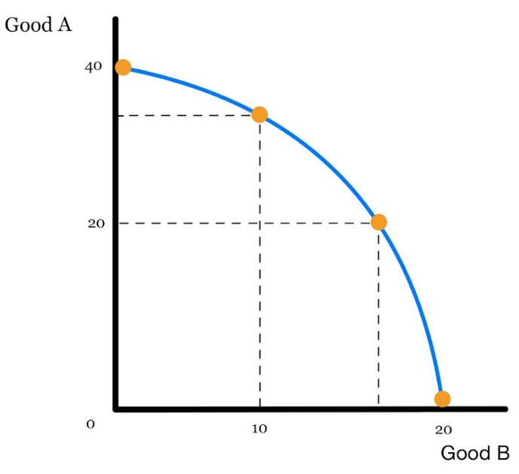
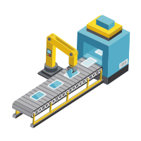
PPC (PPF)
Production Possibilities Curve/Frontier
A model designed to show the alternative combinations a firm or country can produce using their maximum resources.
Assumptions of the PPC
Only 2 goods can be produced
Full Employment (All possible jobs are filled)
Fixed Resources
Fixed Technology
Copyright Bananaomics

Slide 31
Plotting a PPC Curve
Attempt to construct a PPC curve from the information below
Copyright Bananaomics

Slide 32
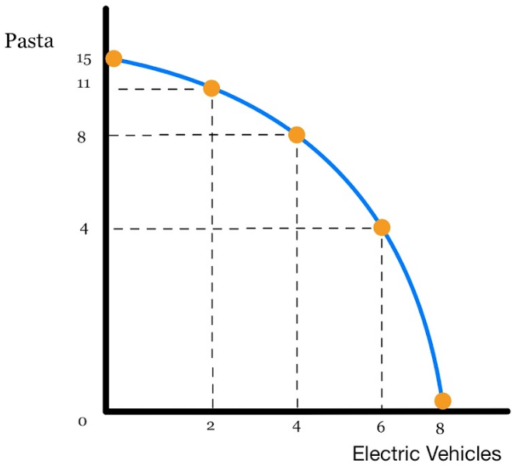
Plotting a PPC Curve
Copyright Bananaomics

Slide 33
Efficiency
Copyright Bananaomics

Slide 34
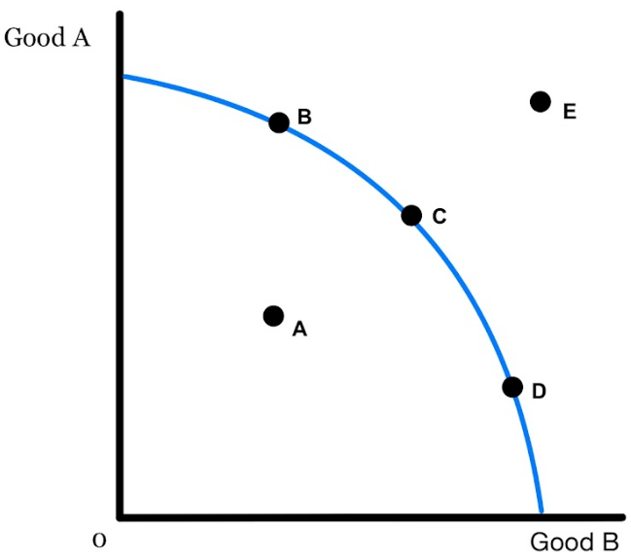
Efficiency
Efficiency - resources are being used in the best possible way. There is no waste and no improvements to be made.
Point B, C, and D - Efficient. All resources are used at their maximum potential.
Point A (Any point inside the curve) - Inefficient as all resources are not being used to the fullest and efficiency could be improved by moving to point B, C, or D.
Point A can also represent an inefficiency due to unemployment.
Point E (Any point outside the curve)- Impossible or unattainable given current resources.
Copyright Bananaomics

Slide 35
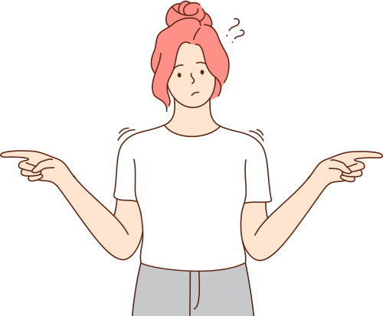
Opportunity Cost, Scarcity, and Choice
Copyright Bananaomics

Slide 36
Opportunity Cost
The PPC model is great for analyzing the concept of opportunity cost.
For example, a movement from point B to point D would represent an increase in the production of Good B.
The opportunity cost would be some quantity of Good A.
Copyright Bananaomics

Slide 37
Opportunity Cost Practice
Copyright Bananaomics

Slide 38
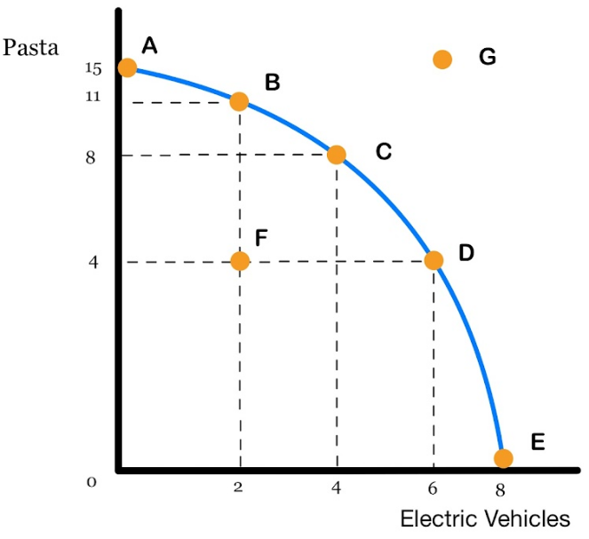
Opportunity Cost Practice
What is the opportunity cost of moving from point C to D?
What is the opportunity cost of moving from point D to A?
What is the opportunity cost of moving from point F to D?
What is the opportunity cost of moving from point A to E?
What can be stated about point G?
What can be stated about point F?
Copyright Bananaomics

Slide 39
Opportunity Cost Practice
What is the opportunity cost of moving from point C to D?
What is the opportunity cost of moving from point D to A?
What is the opportunity cost of moving from point F to D?
What is the opportunity cost of moving from point A to E?
What can be stated about point G?
What can be stated about point F?
4 Pasta
6 Vehicles
No Opportunity Cost
15 Pasta
Unattainable
Inefficient
Copyright Bananaomics

Slide 40
Increasing vs Constant Opportunity Cost
Copyright Bananaomics

Slide 41
Increasing Opportunity Cost
As you produce more of one good, the opportunity cost increases.
Why? Not all resources are equally suited for the production of both goods.
The result of this leads to a 'bowed out' curve.
Copyright Bananaomics

Slide 42
Constant Opportunity Cost
Sometimes, resources can be easily interchanged to produce either good leading to a constant opportunity cost.
A constant opportunity cost results in a straight line PPC.
Copyright Bananaomics

Slide 43
Increasing vs Constant
Copyright Bananaomics

Slide 44
Potential vs Actual
Copyright Bananaomics

Slide 45
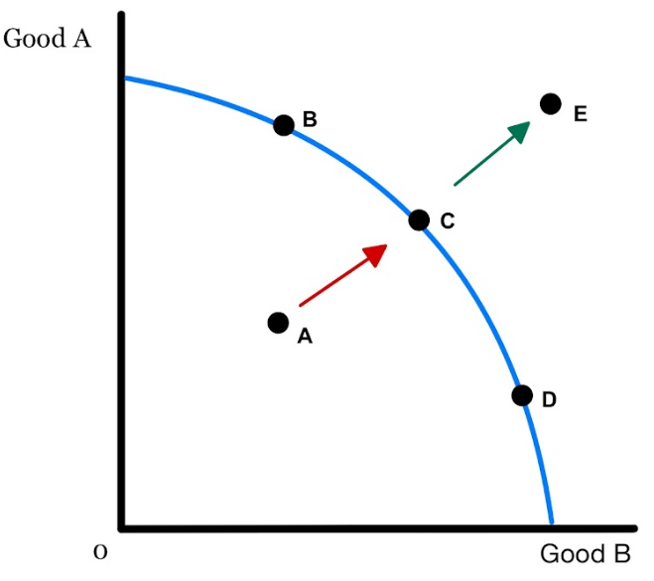
Actual Growth
A movement from point A to Point C illustrates ACTUAL GROWTH.
ACTUAL GROWTH - When growth/efficiency is achieved by making better use of resources.
This is growth that can ACTUALLY happen given current resources.
Copyright Bananaomics

Slide 46
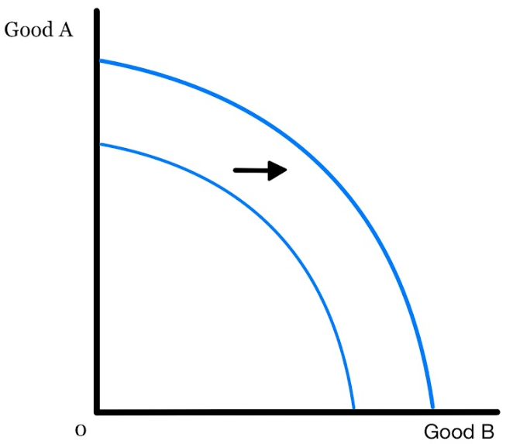
Potential Growth
An increase in the maximum amount that can be produced is POTENTIAL GROWTH.
POTENTIAL GROWTH results in a shift of the PPC. A few things cause the shift of PPC.
Shifters of the PPC (Potential Growth)
1. Change in quantity or quality of Factors of Production
2. Improvement in Technology
Copyright Bananaomics

Slide 47
PPC Practice
Copyright Bananaomics

Slide 48
PPC Practice
Draw a PPC diagram comparing Cars and Ice Cream. Draw the changes for the following:
Note: You should draw a PPC diagram for each question
Be sure to also list the which shifter changes the curve
New Ice Cream Machinery Created
Metal shortage worldwide
An increase of the general population and labour force
Summer time! Ice Cream demand increases
Dairy farms hit by natural disaster
Copyright Bananaomics

Slide 49
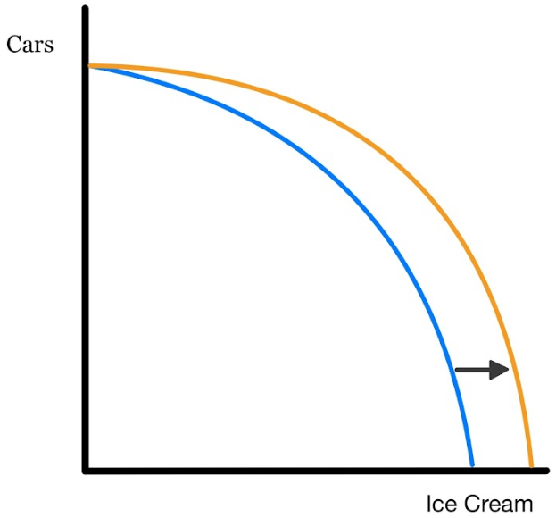
PPC Practice
New Ice Cream Machinery Created
Copyright Bananaomics

Slide 50
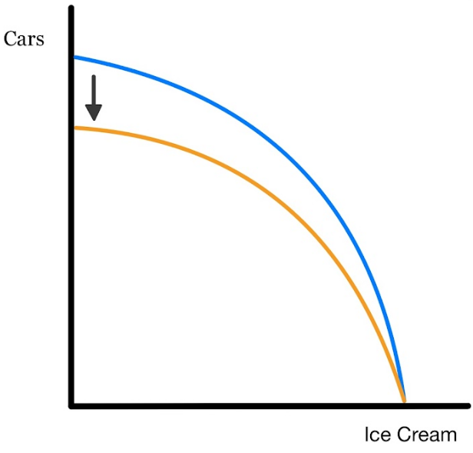
PPC Practice
2. Metal shortage worlwide
Copyright Bananaomics

Slide 51
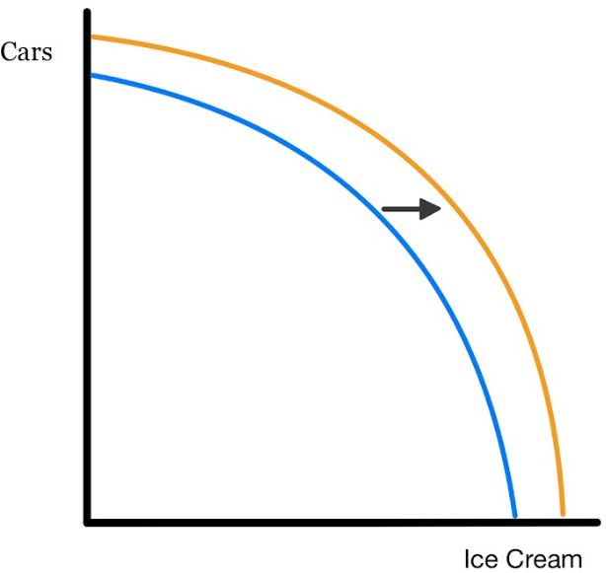
PPC Practice
3. Increase in general population and labor force
Copyright Bananaomics

Slide 52
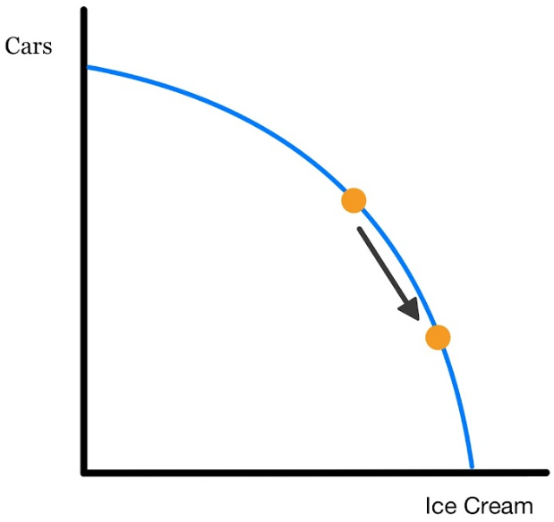
PPC Practice
4. Summer time! Ice cream demand increases
(NO SHIFT = Demand is not one of the shifters)
Copyright Bananaomics

Slide 53
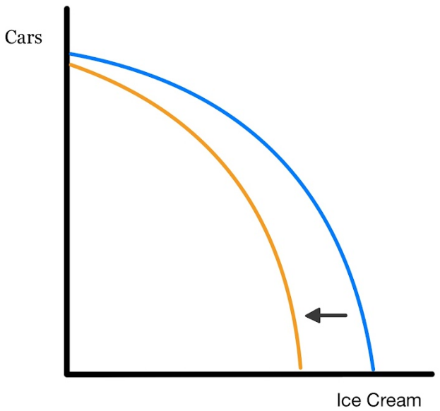
PPC Practice
5. Dairy farms hit by a natural disaster
Copyright Bananaomics

Slide 54
Circular Flow
Copyright Bananaomics

Slide 55
Closed Circular Flow
Households
Goods and Services
Factors of Production
Payment for Goods and Services
Payment for FOP
Product Market
Resource Market
Payment for Goods and Services
Payment for FOP
Goods and Services
Factors of Production
Firms
Copyright Bananaomics

Slide 56
Open Circular Flow
Leakages - Money that flows out of an economy (Savings, Taxes, Imports)
Injections - Money that flows into an economy (Investments, Government Spending, Exports)
OUTFLOW
Households
Goods and Services
Factors of Production
Imports
Savings
Taxes
Foreign Countries
Financial Institutions
Government
Payment for Goods and Services
Payment for FOP
Product Market
Resource Market
Exports
Investment
Government Spending
Payment for Goods and Services
Payment for FOP
Goods and Services
Factors of Production
INFLOW
Firms
Copyright Bananaomics

Slide 57
Practice Question
Copyright Bananaomics

Slide 58
Paper 1 Part A
N09/3/ECONO/SP1/ENG/TZ0/XX
Using at least one production possibility curve diagram, explain the concepts of scarcity, choice, opportunity cost and resource allocation.
Copyright Bananaomics

Slide 59
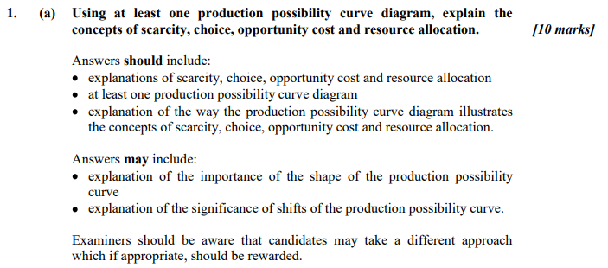
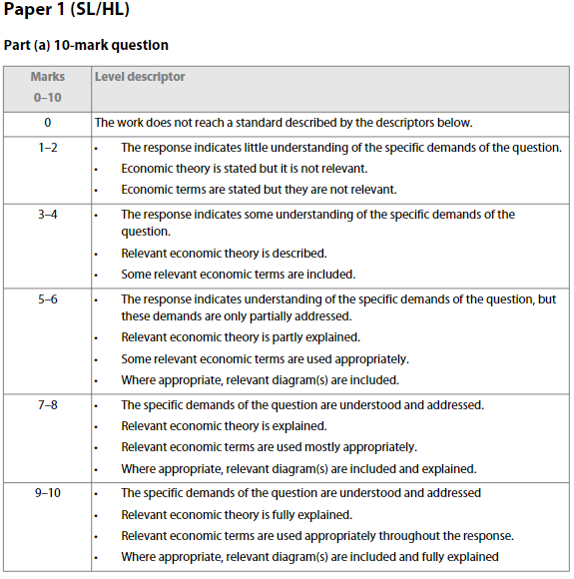
Paper 1 Part A
Copyright Bananaomics

Slide 60
Enjoying The Content?
Visit bananaomics.com to purchase package deals with discount prices!
BANANAOMICS

